Slide 1

An Introduction to ChatGPT
Early implications for educators of students with blindness and low vision
Joe Dlugo

Slide 2
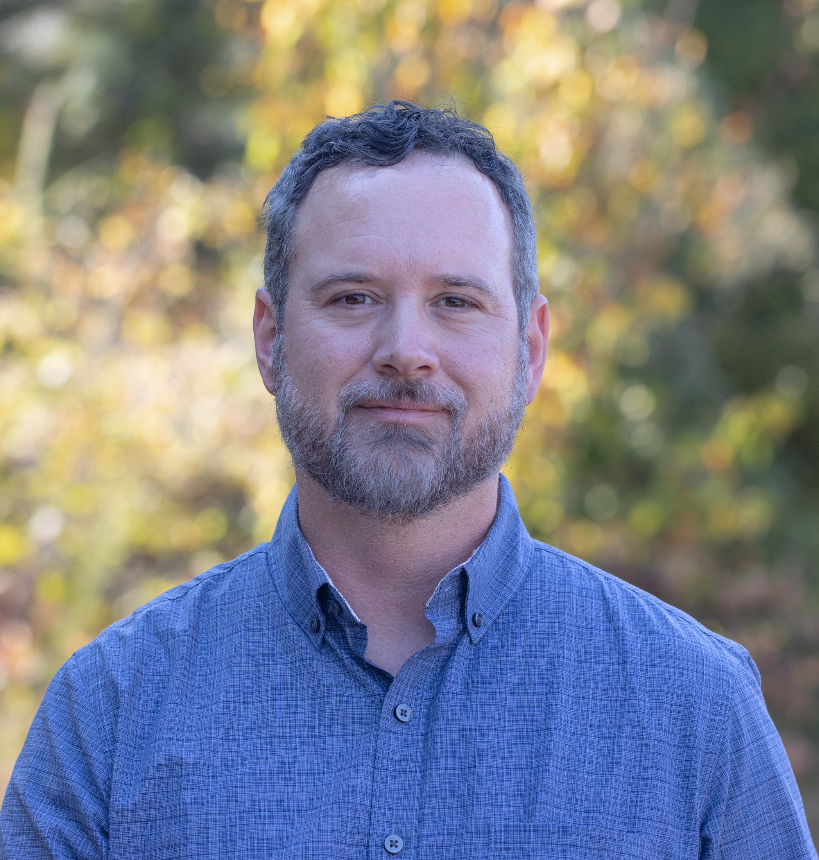
Joe Dlugo
CATIS | TSVI | COMS
Washington State Vision Grant Program Mentor
Washington State School for the Blind Outreach Department
Interests in assistive technology for people with blindness and low vision
Technology “power” user: photographer, videographer, web designer
Strong interest in effects of technology on individual users and society

Slide 3
WHY?

Slide 4
What to expect
Lay the groundwork
Demo ChatGPT
Geek out
Celebrate the potential
Heavy stuff
The path ahead

Slide 5

What is Artificial Intelligence (AI)
The theory and development of computer systems able to perform tasks that normally require human intelligence, such as visual perception, speech recognition, decision-making, and translation between languages (Oxford Languages)
Historical AI: High-tech tools, search engines, virtual assistants (Siri, Alexa, Hey Google), Self-driving vehicles, Seeing AI…
The big news now is Generative AI

Slide 6
Generative AI
First released in 1960s with “Eliza”
Algorithms that are trained on a specific set of information that it uses to create new content such as text, images, or speech
A user inputs a prompt and the system responds in a human-like manner
Machine learning: Recognizes patterns, make predictions, and takes actions
Text: ChatGPT, Google Bard, Anthropic, LLaMA…
Images: Stable Diffusion, Dall-E…
Voice: Lovo, Murf…

Slide 7
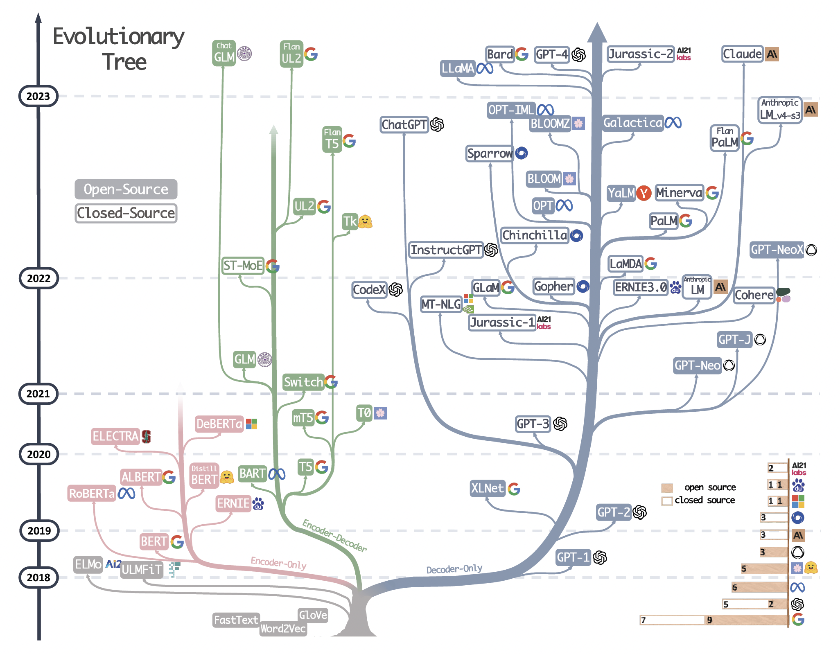
2018-present
Source: Harnessing the Power of LLMs in Practice: A Survey on ChatGPT and Beyond

Slide 8

ChatGPT / GPT-4
Released in November of 2022 by San Francisco-based OpenAI
“Chat” ChatBot – a program designed to simulate conversation with human users
“GPT” -- Generative Pre-trained Transformer (Generative AI)
Funded in large part by a partnership with Microsoft
Accessed via OpenAI website (openai.com) or built into various apps
GPT-3.5 (free) released November 2022, trained on 150 billion parameters
GPT-4 ($20/mo. subscription) released in March 2023, trained on 1 trillion parameters.

Slide 9
Demonstration 1
Classroom teacher suggestions

Slide 10
Demonstration 2
SMART Goal

Slide 11
Demonstration 3
Demonstration of ChatGPT generating a summary of bullet-pointed conclusions from a functional vision assessment

Slide 12
Demonstration 4
Demonstration of Chat GPT analyzing student data and drawing insights

Slide 13
Geeking out: How does this work?
Large Language Models are usually very large (billions to hundreds of billions of parameters) deep-neural-networks, which are trained by going through billions of pages of material in a particular language, while attempting to execute a specific task such as predicting the next word(s) or sentences. As a result, these networks are sensitive to contextual relationships between the elements of that language (words, phrases, etc).
Adi Andrei
Large Language Models Will Define Artificial Intelligence (Forbes Magazine)

Slide 14
Claude Shannon 1948
A Mathematical Theory of Communication
Precision measuring of the quantity of information in a message
The likelihood of some letter or word appearing could be approximated.
The text generated was meaningless but contained approximately the same structure you would see in English.
THE HEAD AND IN FRONTAL ATTACK ON AN ENGLISH WRITER THAT THE CHARACTER OF THIS POINT IS THEREFORE ANOTHER METHOD FOR THE LETTERS THAT THE TIME OF WHO EVER TOLD THE PROBLEM FOR AN UNEXPECTED.
Andrew Markov and Claude Shannon Built the First Language Generation Models | IEEE Spectrum

Slide 15
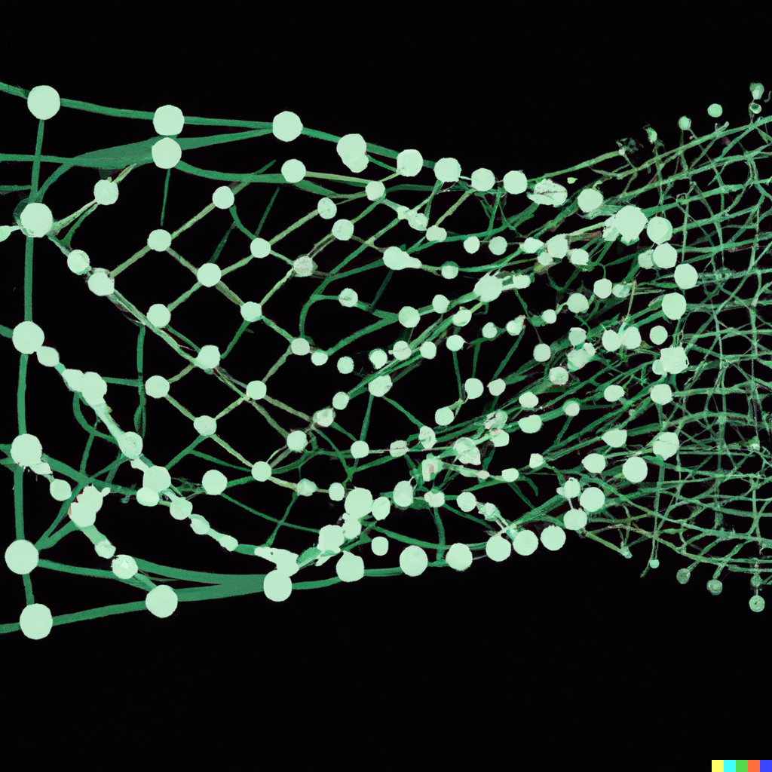
Neural Network
Modeled after function of human brain
Interconnected artificial neurons
Like a team of workers on an assembly line, tasks are passed progressively through the neurons
Although data scientists understand what is happening mathematically, much of the processes remains a mystery due to the sheer volume of neurons involved.
Neural networks developed with large influence from Geoffrey Hinton, who has been in the news

Slide 16
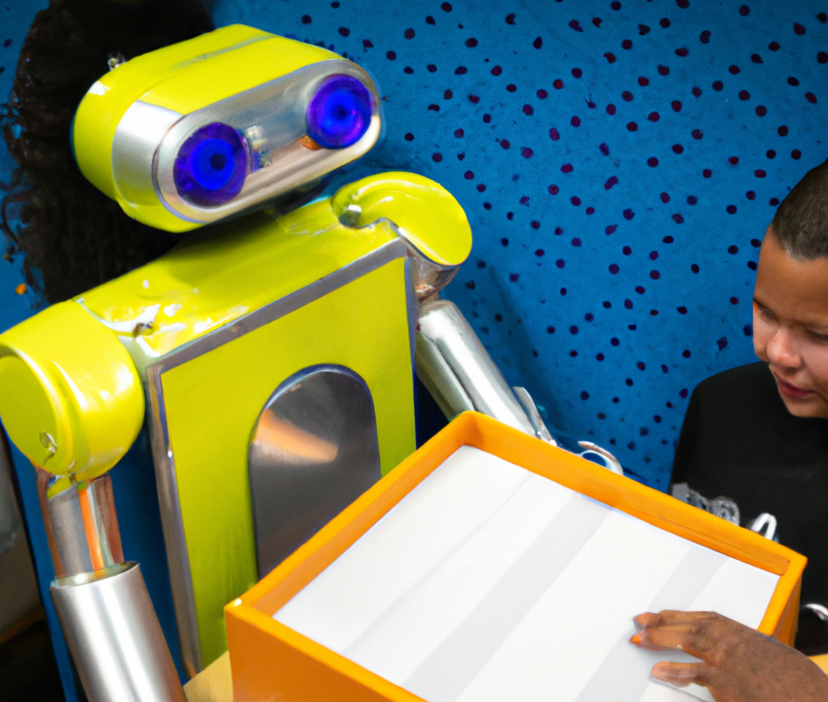
How could this affect for the vision pro?

Slide 17
Potential positive effects for vision pros
Writing reports, goals, lesson planning
Communication: composing emails, articulating thoughts
Personalizing/creation of alternative learning materials and curriculum
Analyze student performance data & provide detailed feedback insights
Greater efficiency, possibly increased time as a teacher
Ability to reach more students in underserved areas
…?

Slide 18
Potential positive effects for students
Personalized tutoring that is easy to access
Enhancing communication: Creative/authoring task support (especially important for those with print disabilities like dyslexia, dysgraphia)
Can help build logical thinking
Can be used to explain ideas and concepts in ways tailored to your student’s functioning level (text leveling, individualized braille materials)
Accessible creative potentials (images, sound, text from a prompt)
*ChatGPT currently is not fully accessible with screenreaders. iOS Voicover seems to be the best experience. Also the Talk-to-ChatGPT Chrome extension can help provide auditory access.

Slide 19
Potential risks and challenges
Misinformation, Incorrect/Incomplete information
Perpetuation of biases and stereotypes
Copyright and intellectual property considerations
Over-reliance on technology, loss of creativity and authenticity
Changing roles of teacher/loss of humanity in education
Greater efficiency = Reduced need for teachers?
…
Unintended consequences…?

Slide 20
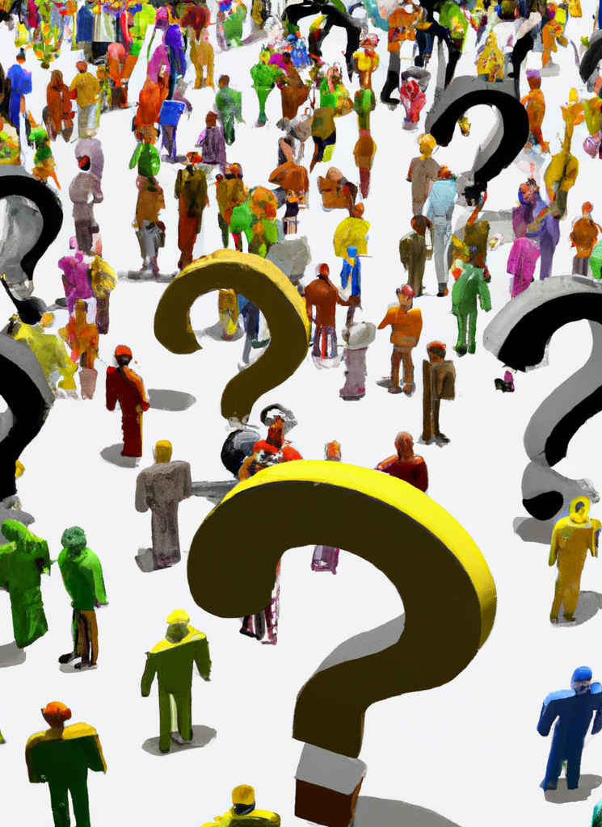
Misinformation
Plausible information vs. truthful information
No filter for truthful data
Automation bias
Fact checking skills will be paramount
Third party software to detect possible untruths?

Slide 21
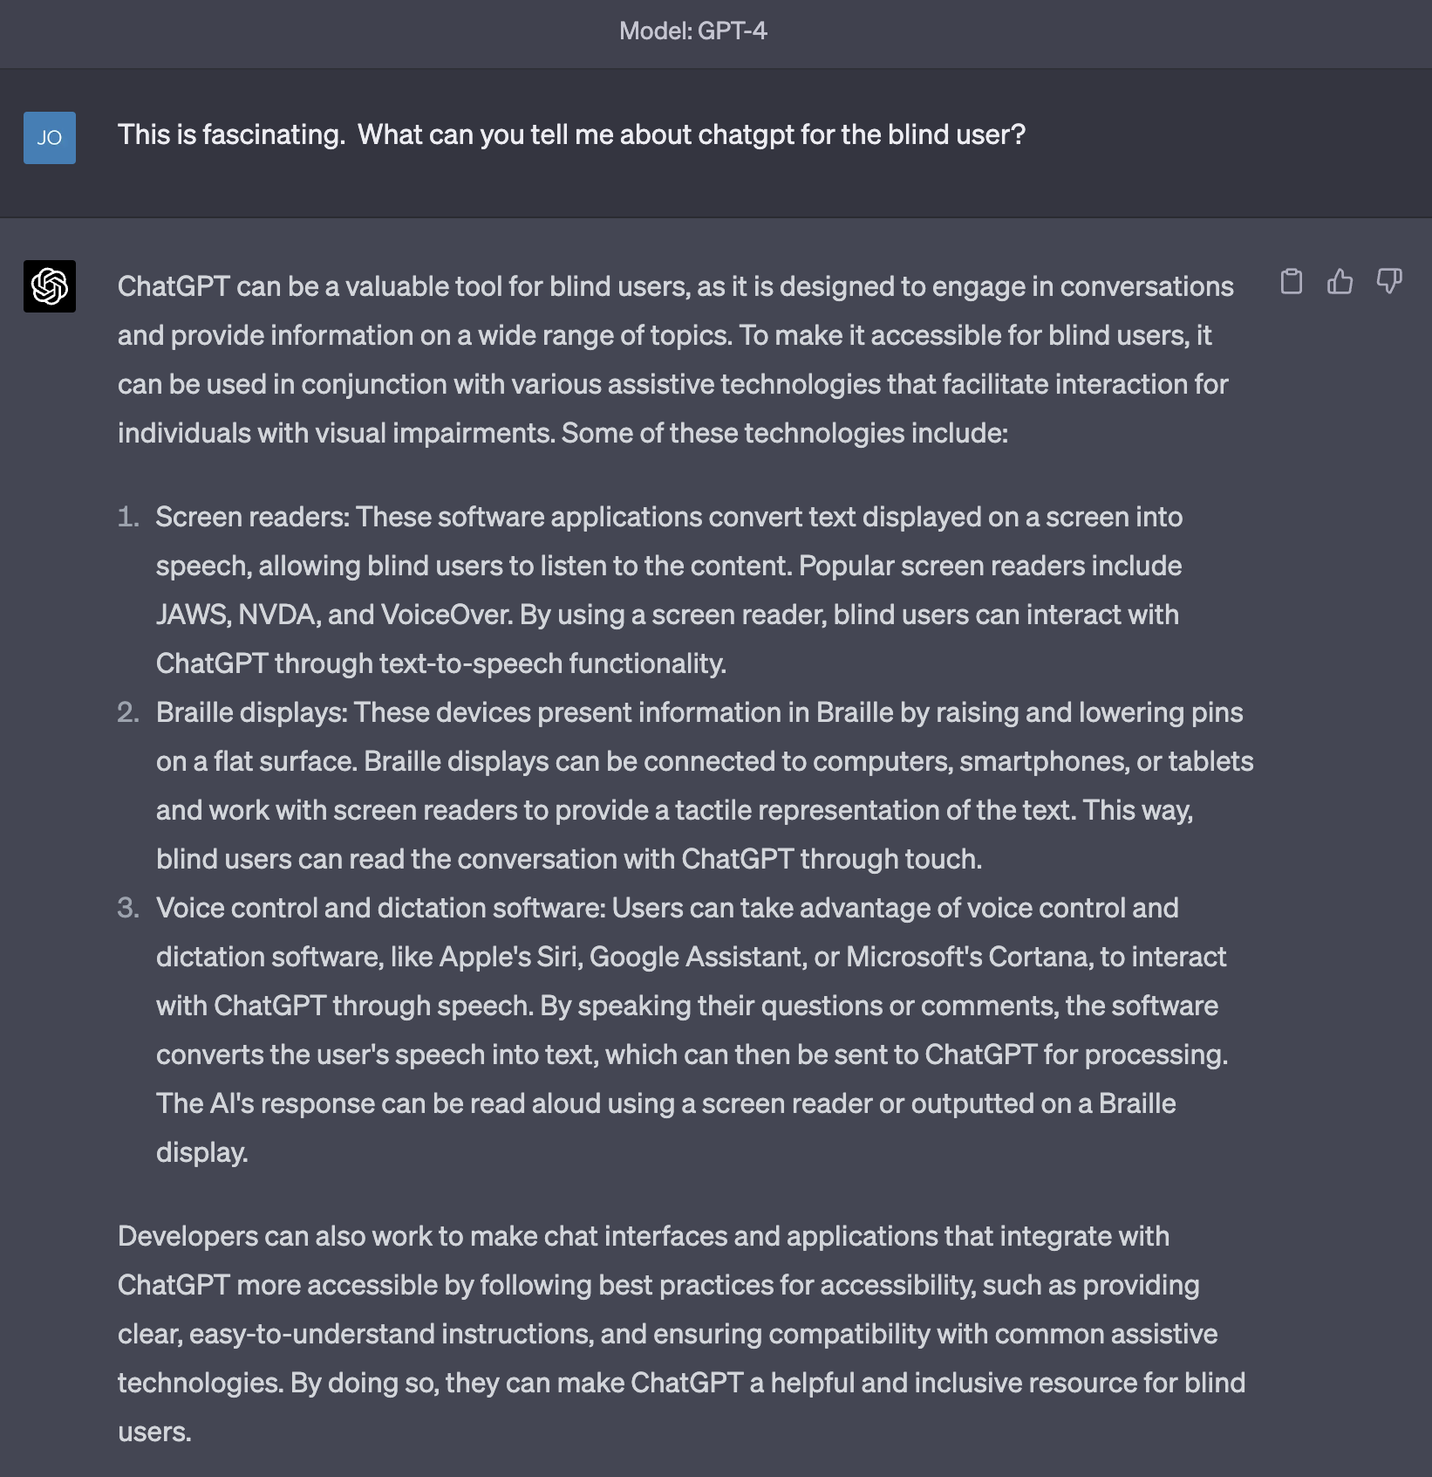
Misinformation
(example)

Slide 22


Perpetuation of biases and stereotypes
“A stylish young blind woman with a white cane holding a coffee cup”

Slide 23
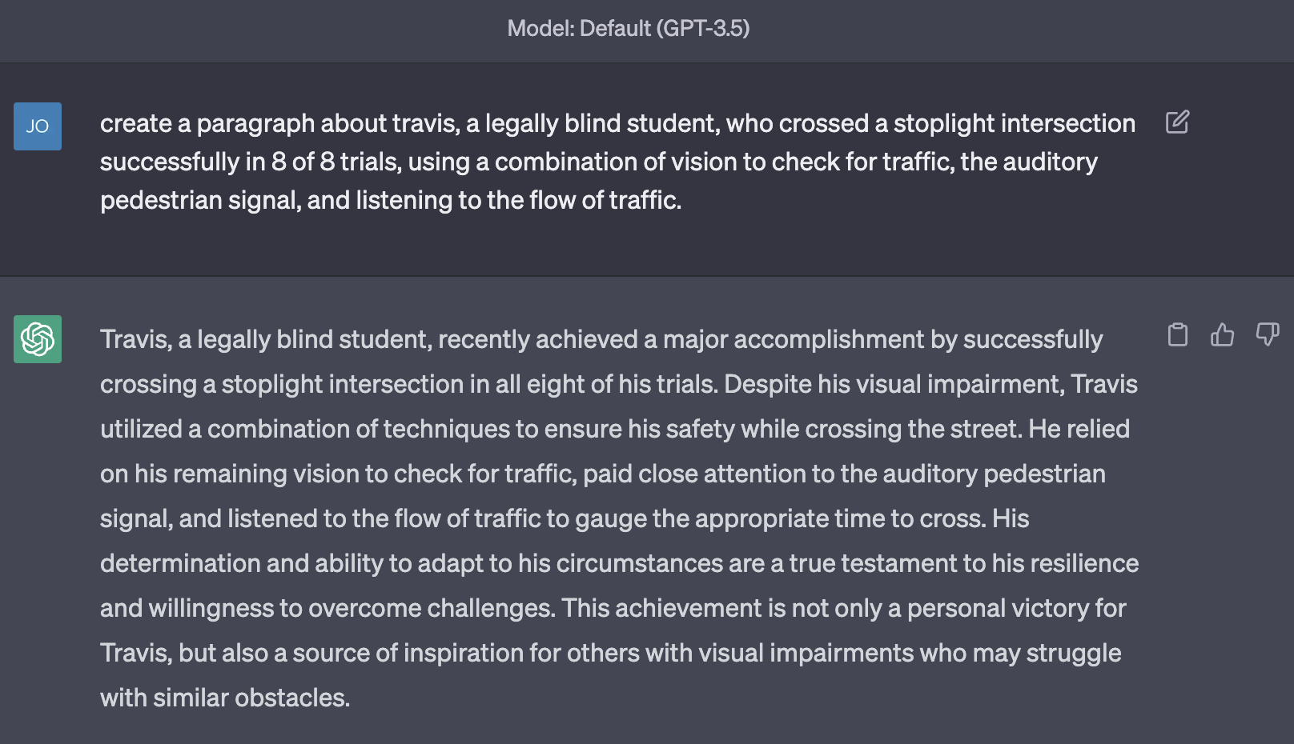
Perpetuation of biases and stereotypes (example)

Slide 24
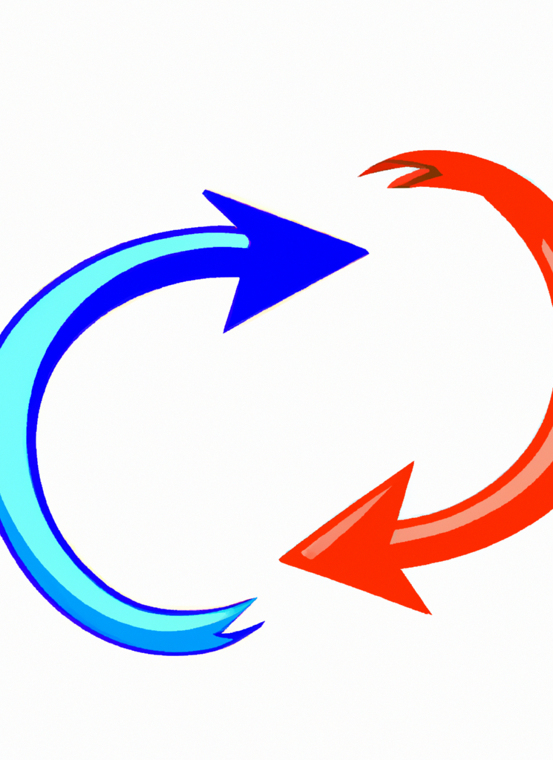
Over-reliance on technology
Information feedback loop
Trained on existing data on the internet
Short term gains might be realized, but in the long term if the tools are used without the technology being trained to new ideas, aspects of our field might stay stagnant

Slide 25

Redefining roles
Teacher…now facilitator?
Specialized expertise that is now easy for all to access
Fears of the loss of humanity from the educational process
Augment ourselves or replace ourselves?

Slide 26
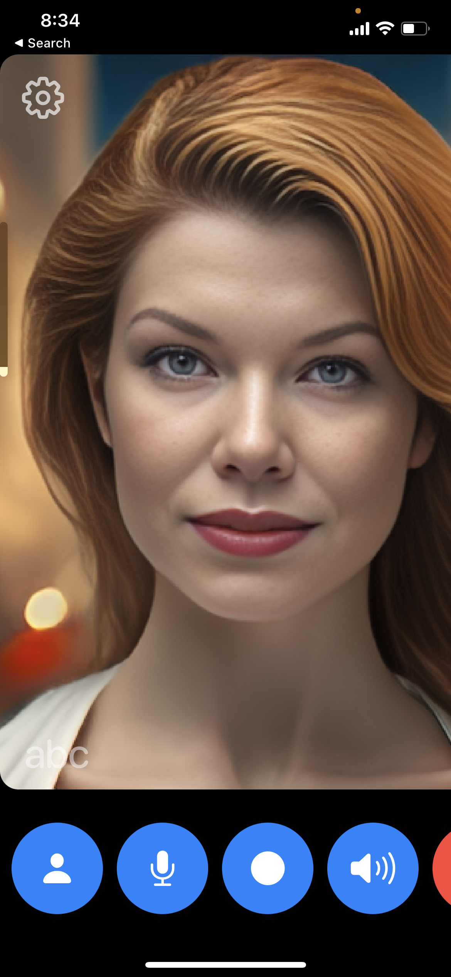
Augmentation vs. replacement
Call Annie App for iOS

Slide 27
Max Tegmark - Time Magazine
Before superintelligence and its human extinction threat, AI can have many other side effects worthy of concern, ranging from bias and discrimination to privacy loss, mass surveillance, job displacement, growing inequality, cyberattacks, lethal autonomous weapon proliferation, humans getting “hacked,” human enfeeblement and loss of meaning, non-transparency, mental health problems (from harassment, social media addiction, social isolation, dehumanization of social interactions) and threats to democracy (from polarization, misinformation and power concentration).

Slide 28
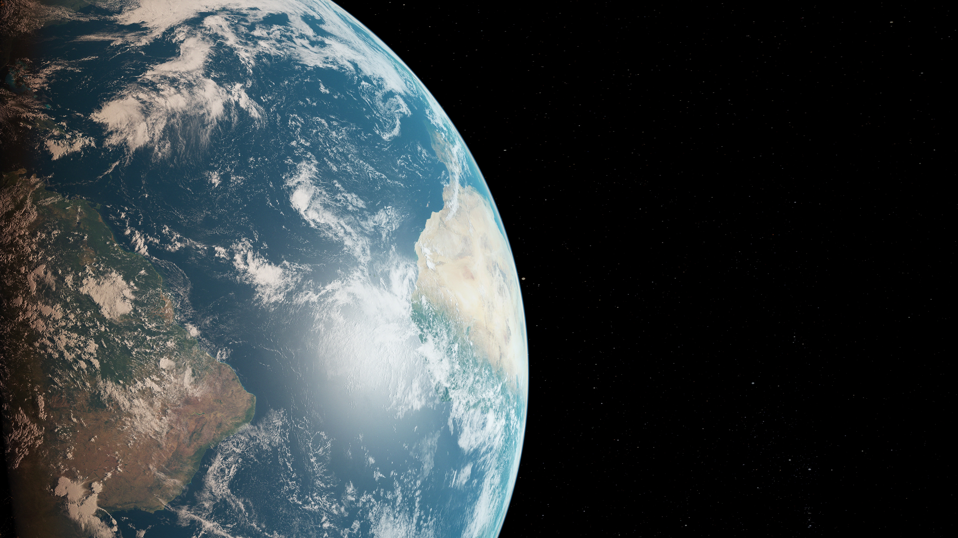
Jeremie Harris Quote
“We’re looking at a world where very high levels of intelligence are very widely distributed, and what you can do with that resource is really up to you as an end user, and there are a lot of end users who want to use things maliciously.”
-Jeremie Harris
Last Week in AI Podcast Host

Slide 29




Three Principles of Humane Tech
Center for Humane Technology
When we create a new technology, we uncover a new class of responsibility
If the technology confers power, it will start a race
If we don’t coordinate, that race will end in tragedy

Slide 30
The path ahead
To ensure the benefits outweigh the drawbacks, it's crucial to initiate discussions about the appropriate applications of these technologies and identify the skills teachers need to use them effectively while mitigating potential risks. We are fortunate to work in an intriguing field that attracts brilliant individuals committed to educating a diverse range of students. This privilege brings with it the immense responsibility to utilize these tools in a manner that enhances our productivity, upholds our values, and fulfills our obligations to our students.

Slide 31
ChatGPT
GPT-3 released November 2022: Trained on 175 billion parameters
GPT-4 released March 2023: Trained on 1 trillion parameters
…?

Slide 32
New endeavors for the vision professional
Get to know the technology, how it is used by yourself, fellow teachers, and students
Advocate that the technologies are made with accessibility in mind
Prepare to adapt
Demand balanced promotion of these technologies—examine use scenarios with an eye on benefits and risks
Work within our places of employment and professional organizations to establish and adhere to ethical standards for AI use

