Slide 1
Educational Tools: APH Mantis Q40 and APH Chameleon 20
Leslie Weilbacher
Bruce McClanahan

Slide 2
Leslie Weilbacher APH Outreach Specialist Northwest Region

Slide 3
Bruce McClanahan Assistive Technology Specialist WA State School for the Blind

Slide 4
Objectives
Gain knowledge of the APH Mantis Q40 and Chameleon 20 and how devices work with computers and mobile devices
Learn about using the Mantis and Chameleon to support literacy for school-age children
Receive tips and strategies on maximizing students’ learning of the Mantis and Chameleon

Slide 5
The American Printing House for the Blind
The American Printing House for the Blind is the world’s largest company devoted solely to creating products and services for people who are visually impaired. APH was founded in Louisville, Kentucky in 1858, making it the oldest institution of its kind in the United States.

Slide 6
The Mantis Q40
40 cell braille display
QWERTY laptop keyboard
Stand-alone features
Connects via USB or Bluetooth
WI-FI

Slide 7
Chameleon 20
Speech – coming soon
20 cell braille display
Perkins style 8 key keyboard
Stand-alone features
Connects USB or Bluetooth
WI-FI

Slide 8
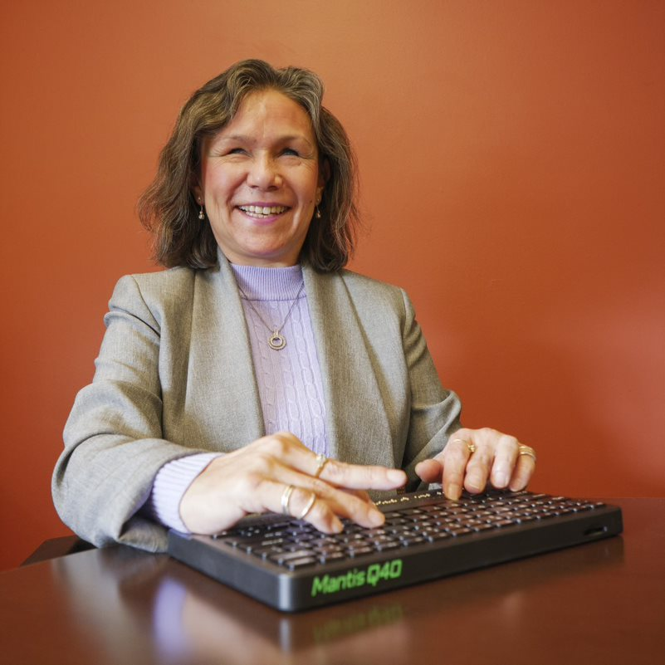
Learning Braille (both)
Toggle between contracted and uncontracted in the Editor (Ctrl+Alt+G)
Multi-modalities when connected to a device with a screen reader
Increase braille access
Reading books in Library from BookShare and NFBNewsline
Braille display iOS Devices, Mac, Chromebooks, PCs, and Android (coming soon)
Notes:
Both the Mantis and Chameleon provide students with access to books such as those available from Bookshare. Once a book is downloaded onto the device, students can read the book on the braille display, navigate to specific pages, and if necessary, they can “carry” the book home with them at the end of a school day. Portability and the option of reading a book anywhere are highly preferred by many students and their teachers.
The Mantis and Chameleon allow students to produce their work by writing in the Editor. Students can write in braille on both devices or type on the Mantis by using the QWERTY keyboard as input. When the written information is saved as a file, it can be uploaded onto another device such as a Chromebook or a computer. Both the Mantis and Chameleon can be used as external keyboards to a laptop or iPad or individual note-takers as well.

Slide 9
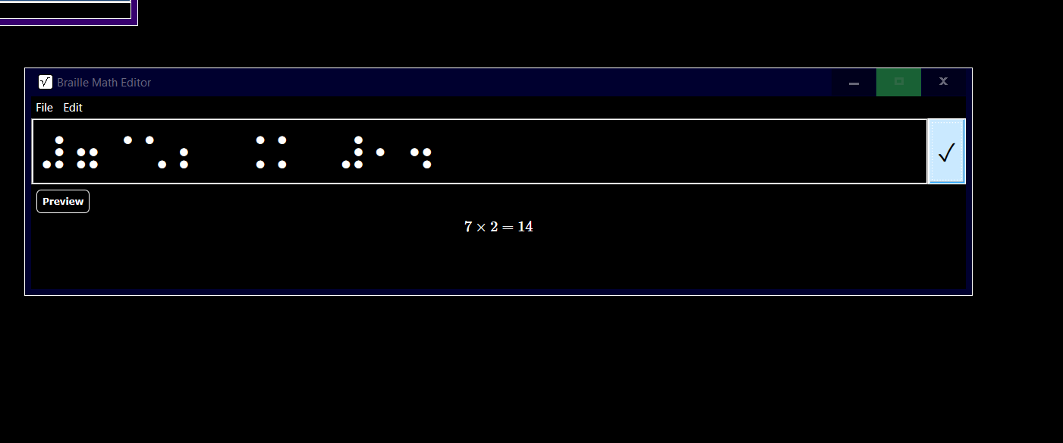
Math Support (both)
Both have a basic Calculator built in
Chameleon can work with the Braille Math Editor in JAWS (Insert + Space, Shift + =)
Both can use the Desmos Online Calculator
To read in Nemeth, set Desmos to braille mode Nemeth and change JAWS output to Computer braille through the options, braille, advanced, general
Notes:
The built-in calculator app allows students to perform basic mathematical functions by entering numbers in braille. When used with the JAWS Braille Math Editor, students can continue to practice their math skills using the Mantis and Chameleon. For many students, these two devices are options for them to improve their math literacy skills.

Slide 10
Comparing: Mantis vs Chameleon
Mantis reinforces letter to letter recognition
Learning to touch type
For some, keyboard layout is more familiar for JAWS
Works with Chrombooks
Chameleon is smaller so more portable
Speech output (coming soon)
Braille entry for Braille Math Editor with JAWS
Braille keyboard for braille character reinforcement

Slide 11
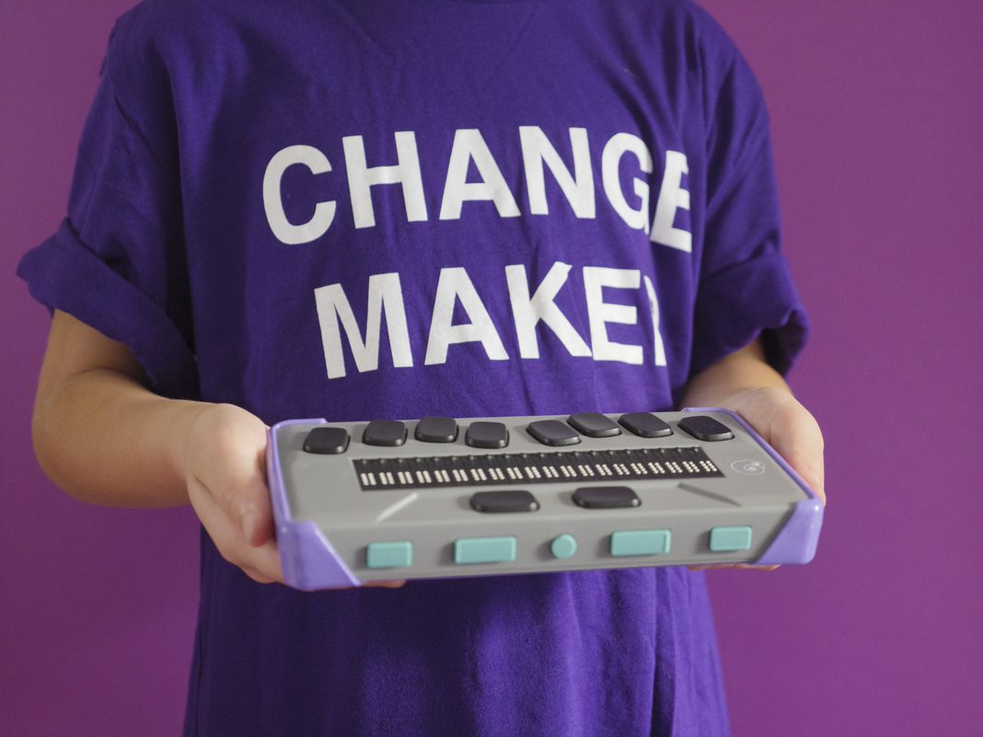
Native Mode and Applications
“Visual” Display

Slide 12
Main structure 1
Editor
Terminal
Library
File Manager
Calculator
Date and Time
Notes:
The latest firmware should always be installed in the APH Mantis Q40 and the APH Chameleon 20.
Both devices have a number of native applications (apps), which will be demonstrated throughout the presentation. The devices do not have a print function; however, they can be connected to a computer while in the Editor, and files can then be transferred to the host computer. The native apps are:

Slide 13
Main structure 2
Settings
Online Services
User Guide
Power Off

Slide 14
Thumb keys
Previous: Move back one level
Left: Pan the Braille display
Home
Right: Pan the Braille display
Next: Move forward one level

Slide 15
Navigation
Home will place the user in the Editor.
Pressing Home always exit Terminal Mode.
Previous button: Move back one level
Next button: Move forward one level
Options are selected by pressing a Braille Router Key or Enter.
Dot 8 is Enter
Dot 7 is Backspace, Delete
First letter navigation

Slide 16
Editor
Create File
Open File
Editor Settings (Confirm deletion on or off)
Close

Slide 17
Create file
Press a Router Key and begin Brailling.
When done press Space+S
Write a filename, enter.
Saved

Slide 18
Terminal
Connected devices
Add Bluetooth device
Back

Slide 19
Library
Check if the school district will support placing this device on their network.
If not, extract the files from BookShare using a Windows PC and copy them manually through the cable or with a USB drive.

Slide 20
File manager
Books
Documents
Online Books
Release Notes
Individual Files
Back
Full Braille cell: Student at the Root/First level folder

Slide 21
Calculator
Four math operations
Percent, square roots, factorials, exponents
Commands must be entered in computer Braille

Slide 22
Date and Time
Date
Time

Slide 23
Settings
User Settings
Braille Profiles
WI-FI
Bluetooth
Active Exam Mode
Software Update
About

Slide 24
Online Services
Press O then enter on Online Services,
Select Bookshare or NFB Newsline
Use the categories or type in the search field
Browse and choose a book to download
DAISY or BRF Books
Add bookmarks and highlights
Notes:
Move through the books with the arrow or thumb keys and press Enter on the title you want to open. The Book List is in alphabetical order. Use first letter navigation to jump to a title beginning with that letter. Use the panning keys to read the book.
Use Ctrl+B to add a quick bookmark. Bookmarks added in order automatically starting at number 1. To highlight a section of text, open the Bookmark Menu with Alt+M. Move to “Highlight Bookmark Start.”

Slide 25
Comments
This device does not print, plug it into a Windows PC or a Chromebook when it is at the Editor, and it will act as a Thumb Drive.
Plug this device in when it says Braille display in Terminal mode. Do this before starting the screen reader.
Use File Explorer for the Windows PC or File Manager for Chromebook to transfer files. File Manager should be taught early in instruction.
The APH Chameleon 20 & APH Mantis Q40 require a 2.4 GHz Wi-Fi connection.

Slide 26
Connecting to devices
PC, Chromebook, iPad, iPhone, Macbook

Slide 27
Connecting – Make Discoverable
Press Home key on Mantis or Chameleon
Press T for Terminal and Enter
Press A and Enter on Add Bluetooth Device
Your device is now discoverable

Slide 28
Windows/JAWS or NVDA
USB to USB C Cable
Bluetooth
Put Mantis in discovery mode
Win, type Bluetooth, enter on Bluetooth & other devices
Toggle Bluetooth on
Choose Mouse, Keyboard, & Pen
Select APH Mantis Q40 xxxxxxxx
Configure APH in the Braille Device Manager in JAWS
Notes:
The APH Mantis Q40 and APH Chameleon 20 work very well with Windows/JAWS. Response from students has been very positive to the APH Mantis Q40 due to the ergonomics of the device and the 40-cell braille display. The JAWS Braille Math Editor is awesome, but the Mantis does not support six-key Braille entry when connected to external devices. The APH Chameleon 20 is required for this feature.

Slide 29
Complete the Connection
Press Home key on Mantis or Chameleon
Press T for Terminal and press enter
Press Enter on Connected Devices
Arrow down to your device’s named and press Enter
You should now be connected

Slide 30
Connecting to IOS Device
Make your device discoverable
On iPad activate VoiceOver
In settings, Bluetooth and tap on your APH device
Press Home key on Mantis or Chameleon
Press T for Terminal and press enter
Press Enter on Connected Devices
Arrow down to your device’s named and press Enter
You should now be connected

Slide 31
Predictive Text
On iPads
IA Writer
Enter text field
Shift braille cursor focus to predictive text suggestions
Press enter on the word that you wish to insert
Notes:
Both the APH Mantis Q40 and the APH Chameleon 20 work well with iPads, it is required that iOS 15 or later be installed or this will be a negative experience.
Almost everyone uses word prediction. Equity is critical, and it so unfair that up to now blind students have not had access to word prediction. With the APH Mantis Q40 and iA Writer word prediction works great. Place the Braille cursor on the word prediction suggestions.

Slide 32
Chromebook/ChromeVox
The Mantis works with ChromeVox very well
Use the USB cable for best connection
Capslock key becomes Search key
Notes:
The APH Mantis Q40 is the recommended device for use with Chromebooks. This device has been well received by students because the braille display is integrated into a QWERTY keyboard. QWERY input works great with Chromebooks but braille input currently does not work well yet. We have found that some basic modifications, such as, changing the Caps Lock key to Search or using a permanent marker to write the Chrome OS equivalents above the Function Keys are beneficial for students. Additional tips on using this device will be shared during the presentation.

Slide 33
Quick Tips
1. Context Menu (right click)
Space M for Chameleon
Ctrl M for Mantis
2. Use the Braille Viewer in JAWS to see what is on the students display in print and SimBraille on the screen
Go to Utilities, Braille and Text Viewer, Enable Braille Viewer
Insert+Space, B, B
Or say "Sharky, start Braille Viewer"

Slide 34
Resources and Reach out!
Link to APH Chameleon 20 Webpage
Link to APH Mantis Q40 Webpage
Link to list of Resources
Link to Braille Display Comparison Chart
Link to Downloading and Marking Up Books
Link to NFB Newsline with the Mantis and Chameleon
Link for Mantis Hotkeys doc
Link for IOS Mantis Hotkeys
Link to Chromvox Hotkeys QWERTY
Link for Chameleon Hotkeys doc
Link to IOS Chameleon Hotkeys
Link for Mantis and Chameleon User Group
Link to Bruce McClanahan Manuals

Slide 35
APH Resources
National Prison Braille Network
Museum
Migel Library
Hall of Fame
InSights Art Contest
Accessibility Hub
NIMAC
Louis Database
Tactile Graphics Image Library

Slide 36
The Hive
One-stop shop for professional development
FREE
ACVREP credit
Resources
Self-paced learning
Peer Reviewed
Notes:
The APH Hive offers the best of BOTH worlds: It's a one-stop shop for quality professional development which will help you further build your teaching expertise for FREE and ACVREP credit which easily translates into any sort of certificate of completion towards earning Continued Education Units (known as CEUs). The courses within the APH Hive include many unique Resources, which you'll only be able to find with APH. And all of this occurs given a self-paced learning framework. Because let's face it. We are all busy. Super busy. And the Hive is built in a way that helps busy people like yourselves... the self-paced, asynchronous learning, can be done wearing pajamas at 5:30 in the morning or 11pm in the evening.

Slide 37
Thank you
Leslie Weilbacher
lweilbacher@aph.org
outreach@aph.org
Bruce McClanahan
Bruce.mcclanahan@wssb.wa.gov

