Slide 1
Switch Access for Blind and Low Vision Students
Bruce McClanahan, Assistive Technology Specialist
Washington State School for the Blind

Slide 2
Resources
https://www.wssb.wa.gov/welcome-to-wssb/services/statewide-technology-services/
All materials on this page have links to all the other resources that I am aware of.
iPad and Chromebook Apps accessible for blind and low vision students with significant additional impairments.
Chromebook manual
APH Chameleon 20 & APH Mantis Q40 manuals
Duxbury manual
JAWS manual
VoiceOver manual
More…

Slide 3
Project Euphonia
https://sites.research.google/euphonia/about/
Project Euphonia is a Google Research initiative focused on helping people with atypical speech be better understood. The approach is centered on analyzing speech recordings to better train speech recognition models.
Must be over 18 to participate.

Slide 4
Low Tech
AbleNet Little Step-by-Step: https://www.ablenetinc.com/little-step-by-step/
Single Message: https://www.ablenetinc.com/talkingbrix-2/
Some TVI’s have purchased single message communicators on Amazon.
Resource “Making Connections” from Amazon. “A Practical Guide to Bringing the World of Voice Output Communication to Students with Severe Disabilities.”

Slide 5
OT/PT Involvement
Requirement before the first visit, determine that the OT or PT has been involved and has determined appropriate switch placement for this student.
If an SLP can be involved that would be awesome.

Slide 6
Tips
Tactually mark the iPad. The APH Feel ‘n Peel stickers work well. Some of the Duck Duck Moose apps can be made accessible this way. For example, Wheels on the Bus. (All of the Duck Duck Moose apps are now free.)
USB devices will work on the Chromebook if they do not require any drivers to install. If you have an old Don Johnson Switch Interface, no longer made, it is going to work.
Tactualize the switches, APH makes excellent materials for this.
Switch Progression: http://www.inclusive.co.uk/Lib/Doc/pubs/switch-progression-road-map.pdf
Most apps made for special needs students are not accessible for blind students.
The more ports a switch interface has, the better.

Slide 7
Switch Interfaces Part 1
APPlicator: https://www.inclusivetlc.com/applicator Bluetooth. This device has 4 ports, each port can have 22 individually assigned options. Uses iOS Switch Scanning, current device. iPad or Chromebook
Switch2Scan: https://www.inclusivetlc.com/switch2scan Bluetooth. This device 4 ports. It has a VoiceOver component and is older. iPad or Chromebook
Pretorian USB Switch Interface: https://www.inclusivetlc.com/pretorian-usb-switch USB. This device can support 3 switches, each switch can have 22 individually assigned options. Chromebook/Windows/Mac
More

Slide 8
Switch Interfaces Part 2
Simple Switch: https://www.inclusivetlc.com/simple-switch-box USB. This device has two ports. Left and Right Click or Spacebar and Enter. Chromebook/Win/Mac
AbleNet Blue2: https://www.ablenetinc.com/blue2-bluetooth-switch/ Bluetooth. This unit has two Ports. It has 6 modes, 3 of the modes can be configured by plugging in a USB keyboard. iPad or Chromebook
ATEC Computer Switch Interface: https://www.adaptivation.com/product-page/usb-switch-interface-by-atec USB. This unit has 5 ports that can be assigned 5 different options. Chromebook/Windows/Mac
IntelliKeys USB Keyboard and APH Braille Overlays: (No longer made but can be used as a switch interface.) http://atmakers.org/intellikeys/ Windows

Slide 9
iOS Switch Scanning Suggestions
Gliding Cursor in iOS Switch Scanning can’t be turned off, set it to Single and the fastest speed so it is less annoying.
Configure two or more external switches
Scanning Style: Manual
Tap Behavior: Always tap
Sound Effects: On
Speech: On
Group Items: Off
Large Cursor: On
Explore “Recipes” an advanced method to configure iOS Switch Control

Slide 10
Switch Accessible Software
I maintain a list of switch accessible software on the WSSB Statewide Technology page, mentioned earlier in this presentation. There are not many switch accessible apps for totally blind students with significant additional impairments.
Enabling Devices has a list of switch accessible apps that work with children with usable vision. https://enablingdevices.com/wp-content/uploads/2018/09/Switch-Accessible-Apps-2018.pdf
The key content for switch accessible apps is always spacebar for switch 1 and enter for switch 2.

Slide 11
Tar Heel Reader & Tar Heel Gameplay
These web sites are awesome.
They will work with an iPad, Chromebook, Windows, or Mac.
https://tarheelreader.org/
https://tarheelgameplay.org/

Slide 12
Switch Access & Alexa
Use AAC apps or Sounding Board and configure this software to link to Alexa.
Sounding Board is a switch accessible app.

Slide 13
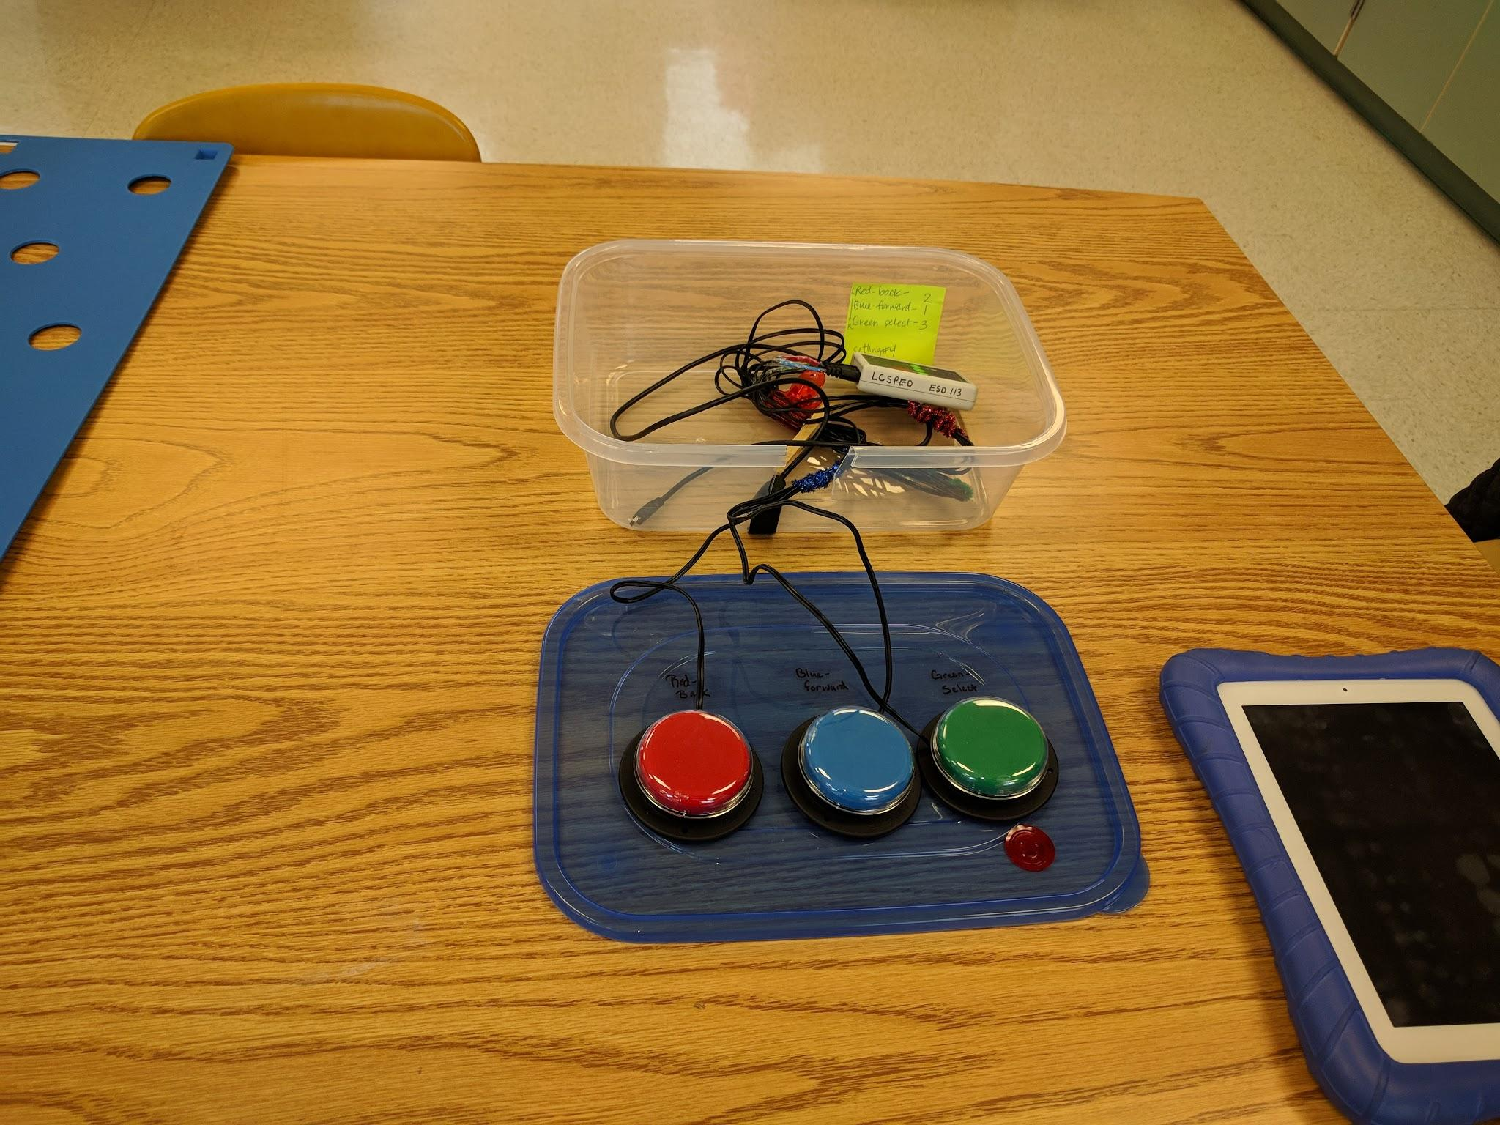
Switch2Scan: 3 Switches

Slide 14
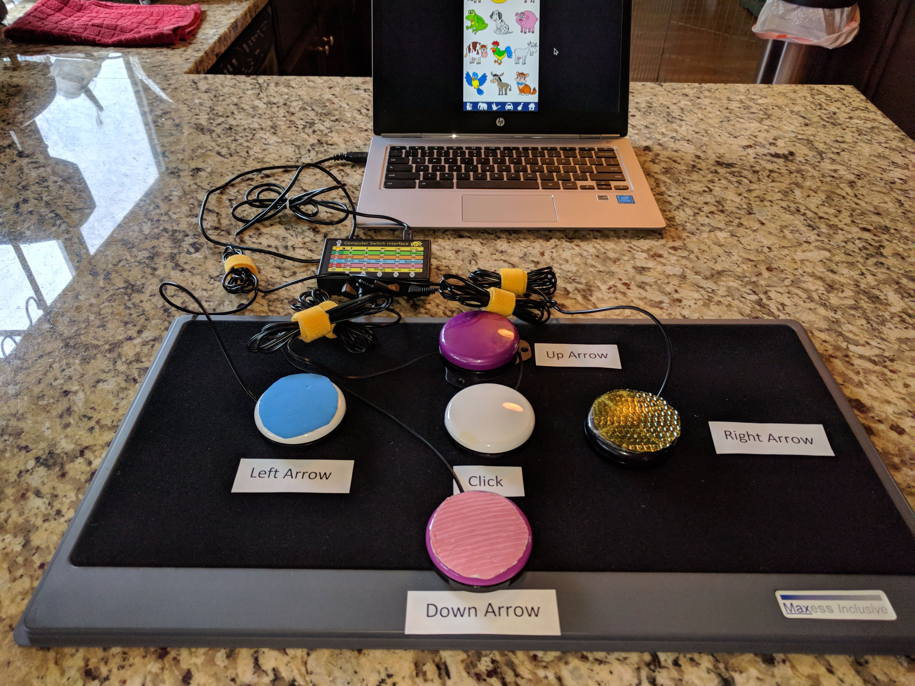
Sound Touch Switch Access

Slide 15
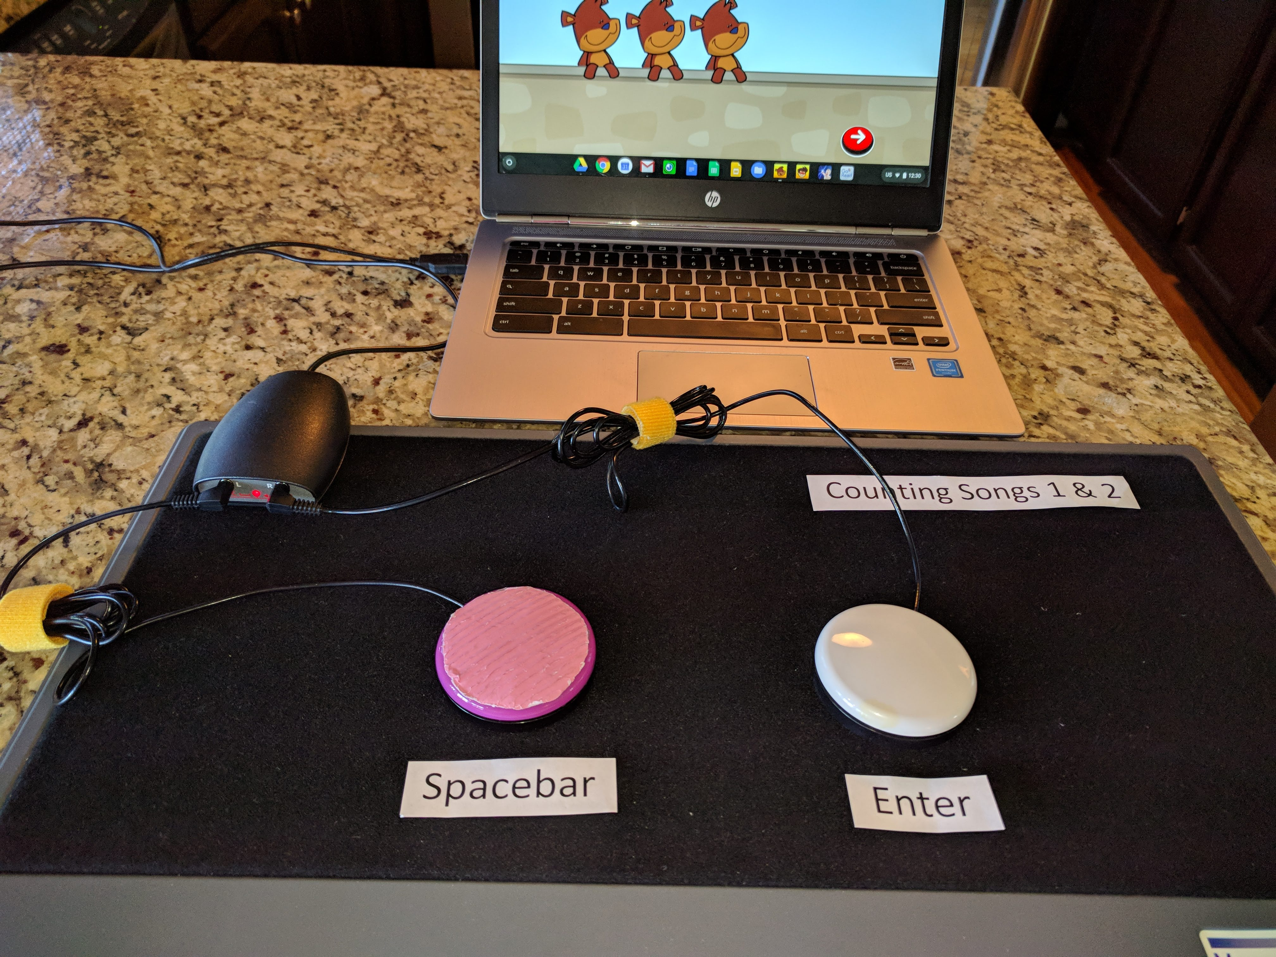
Counting Songs 1

Slide 16
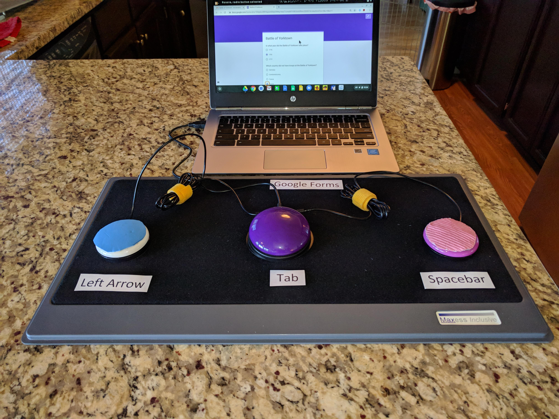
Google Forms Switch Access

